Slide 1

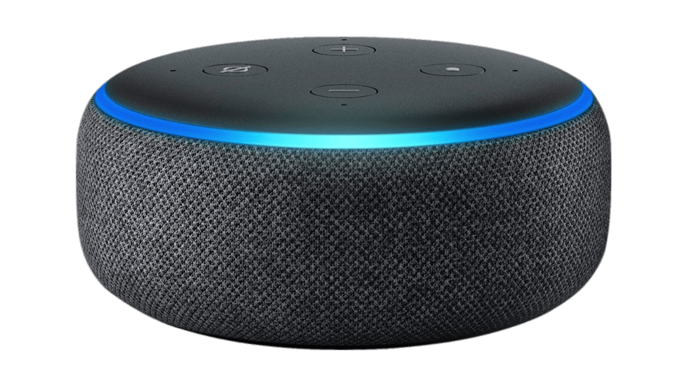









Table of Contents
How VVAs work
Virtual Voice Assistants (VVAs) and the role of the GDPR
How VVAs work
Personal Data & GDPR
Alexa & Privacy
Smart Assistants
Behind the scenes
DPIA
Privacy Concerns
Possible Solutions
Violations of GDPR
Information and Technology Law
Andrea Fabbri, Giacomo Lombardi, Giacomo Maldarella

Slide 2
How VVAs work
Smart Assistants
Behind the scenes
Privacy Concerns

Slide 3
Smart Assistants
Enable natural language oral communication
Understand and respond to user requests
Perform physical tasks on connected devices

Slide 4
Privacy concerns
Continuous listening
Collection of personal data extends beyond the direct user to the surrounding environment
Potential surveillance and profiling of individuals

Slide 5



Behind the scenes
The Echo device is in constant listening mode, but until it detects the wake word, it does not transmit any audio and performs no operation other than detecting the specific word
Alexa, tell me the weather in Pisa.
The request is encrypted and transmitted to the Amazon cloud
Recognition process filters the sound to isolate only the specific word, activating the device and ignoring other sounds.

Slide 6
Behind the scenes
The Echo device is in constant listening mode, but until it detects the wake word, it does not transmit any audio and performs no operation other than detecting the specific word
Alexa, tell me the weather in Pisa.
The request is encrypted and transmitted to the Amazon cloud
Recognition process filters the sound to isolate only the specific word, activating the device and ignoring other sounds.

Slide 7





Word verification
Automatic Speech Recognition (ASR) converts the audio into text
Natural Language Understanding (NLU) technology assigns meaning to the text
Voice recordings and transcriptions of requests are securely stored in the Amazon cloud
Text-to-Speech conversion function generates a vocal response and sends it back to the device

Slide 8
Behind the scenes
The Echo device is in constant listening mode, but until it detects the wake word, it does not transmit any audio and performs no operation other than detecting the specific word
Alexa, tell me the weather in Pisa.
The request is encrypted and transmitted to the Amazon cloud
Recognition process filters the sound to isolate only the specific word, activating the device and ignoring other sounds.

Slide 9
Table of Contents
How VVAs work
Personal Data
&
Alexa & Privacy
GDPR
DPIA
Violations of GDPR
Possible Solutions

Slide 10





Personal Data
Different types of Data and Stakeholders
GDPR
Transparency
European Data Protection Board (EDPB)
Purposes of Data Processing
The processing of voice data by Smart Assistant must be based on a legal basis clearly outlined in the privacy policy
Data Minimization
Users’ Rights
Art. 6

Slide 11
Different types of Data and Stakeholders
Data categories
Types of users
Primary
Registered users
Account data and Voice Recordings
Observed
Unregistered users
Device Data and Online Activities
Derived
Accidental users
User profiling

Slide 12



Transparency
Art. 12 and 13
Transparency is crucial in Smart Assistants’ data processing
They must comply with GDPR’s Article 12 and 13 and clearly communicating the processing of personal data
Failure to communicate represents a violation with impacts on the lowfulness of data processing
This principle should be ensured from the early stages of interaction, especially considering unwanted activations of Smart Assistants.
In the case of accidental processing of data, the Data Controller must verify the legal basis for each purpose and, if lacking, proceed with the deletion of accidentally collected data.

Slide 13




Purposes of Data Processing
Art. 6 and 9
Execution of Requests
Improvement through Training and Manual Review
User identification using voice data
Profiling

Slide 14
Data Minimization
Art. 5(1)(c)
Reduce the amount of information collected
Avoid data analysis
Proper Default Settings
Limit the knowledge about habits or medical issue
Reduce the amount of information at the minimum

Slide 15



Mechanisms for the exercise of interested party rights
Access Right
Rectification Right
Deletion Right
Registered and unregistered users

Slide 16
Mechanisms for the exercise of interested party rights
Access Right
Rectification Right
Deletion Right
Registered and unregistered users

Slide 17


Access Right
Art. 15
Every user should be able to access his personal data in a common format
Every user should be able to access his personal data in a common format
Audio Data
Audio Data
Transcription
Vocal Recording
Transcription
Vocal Recording
No need to buy a specific software

Slide 18



Rectification Right
Art. 16
Logged in users
No logged in users
Modify or Update personal data at any time
Modify or Update personal data at any time
Profile Management Application
Update should be notified verbally or by texting
Profile Management Application
Update should be notified verbally or by texting

Slide 19



Deletion Right
Art. 17
All user’s data deleted after a request
Logged in or not
All user’s data deleted after a request
Using a voice command to facilitate the process
Using a voice command to facilitate the process
Deletion right may be subject of technical or legal limitation

Slide 20

Table of Contents
How VVAs work
Personal Data & GDPR
Alexa & Privacy
DPIA
Violations of GDPR
Possible Solutions
CASE STUDY

Slide 21

Alexa & Privacy
CASE STUDY

Slide 22




is GDPR compliant?
How does Alexa reduce the amount of collected data?
Amazon Profile Management application with an integrated smart assistant that can manage different devices and facilitate the exercise of the previous rights
Alexa Application

Slide 23



Example of Data
Data Controller & Processor
Purposes
Login, email address, password
Position, Ip address
Payment information
Pictures and videos related to Amazon
Audio Recordings
Information about Smart House devices
Contacts, in case you use Alexa’s Call and Message service
Answer to users’ requests
Improving the Alexa service
Voice ID creation
Suggestions and personalization
Advertising
Activities carried out by other companies on behalf of Amazon
Amazon Europe Core SARL, Amazon EU SARL, Amazon Services Europe SARL e Amazon Media EU SARL e Amazon Digital UK Limited ("Amazon Europe").

Slide 24
How does Alexa reduce the amount of collected data?
Data Minimization
Sending information to the cloud only if the wake word is detected
Trying to minimize the backgroud noise transmitted
Recording the smallest amount of necessary audio

Slide 25
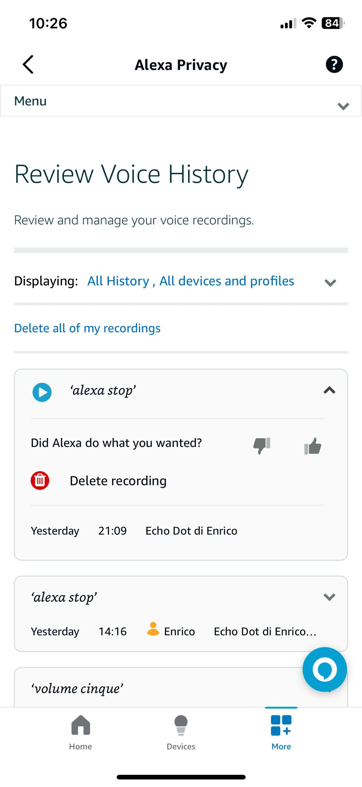
Access with Alexa Application
Access to audio data
What data are displayed
Registration & transcription
When the data have been registered

Slide 26
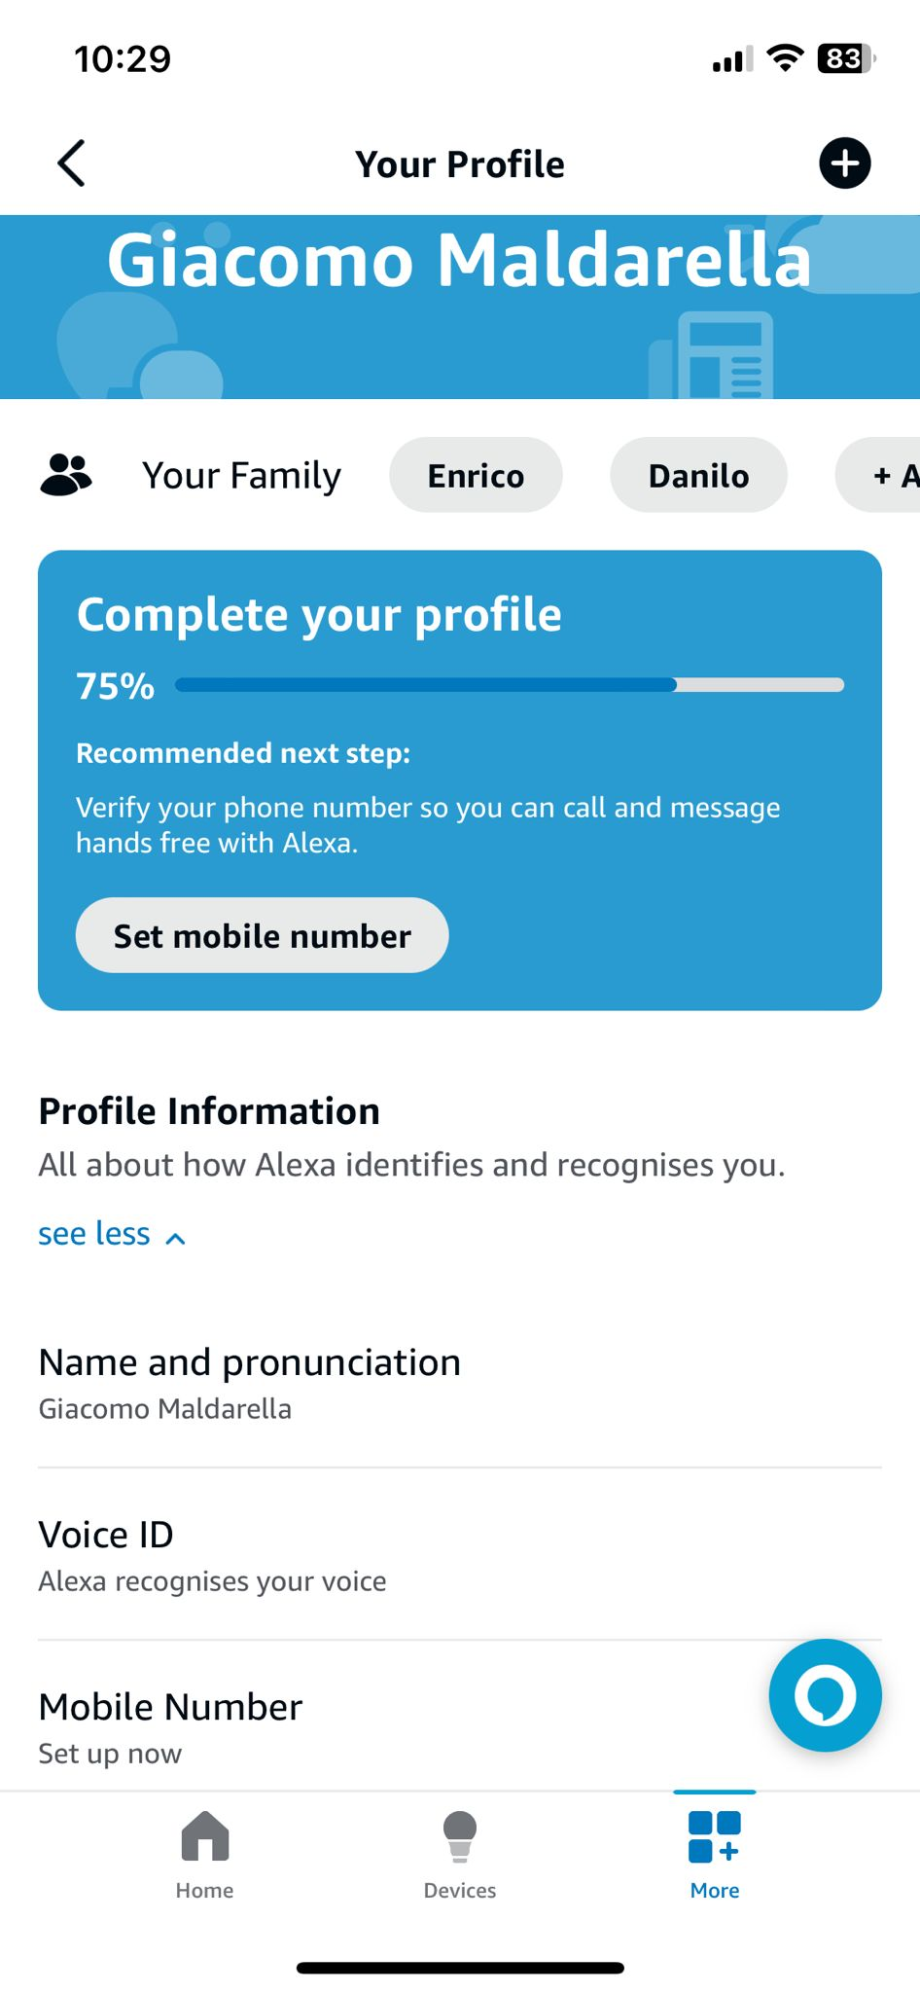
Your account
Rectification with Alexa Application
Family members
Editable personal information

Slide 27
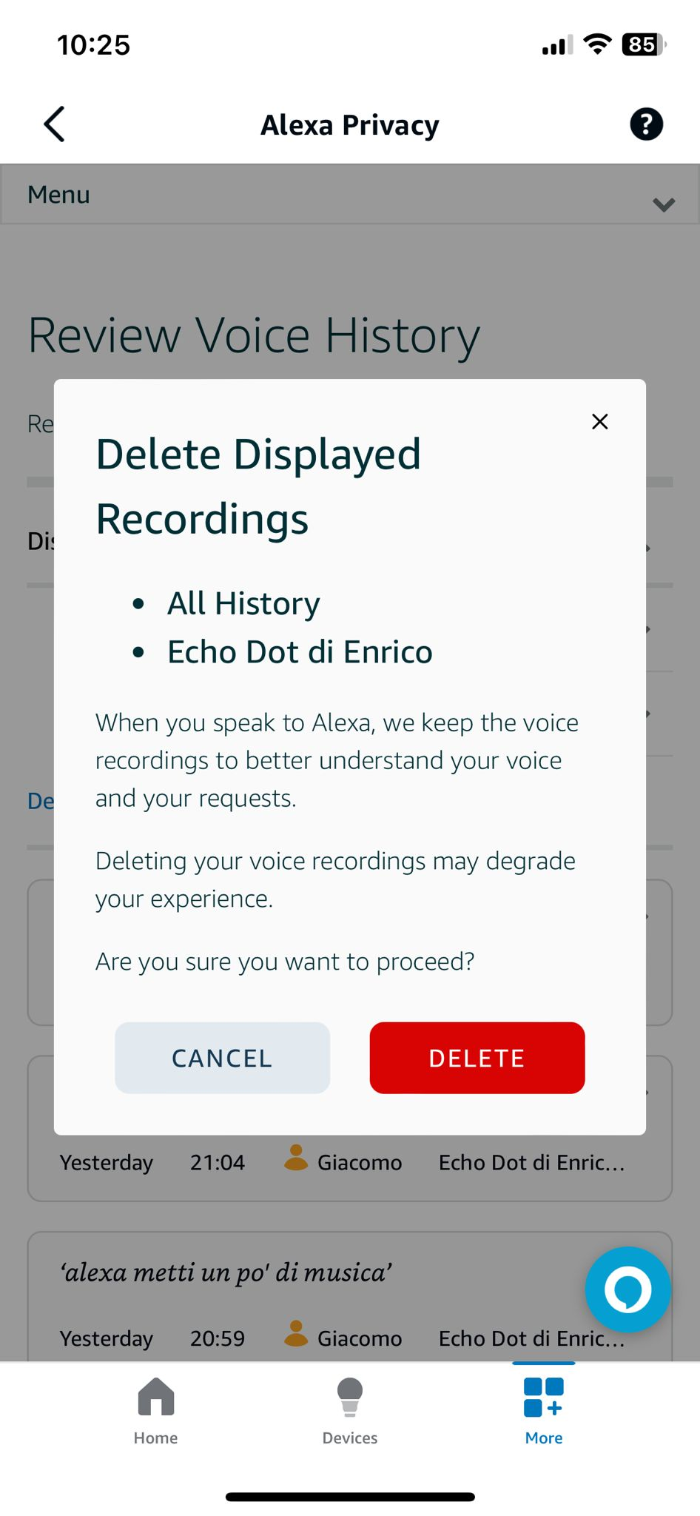
Deletion with Alexa Application
Different possibilities

Slide 28
Deletion with Alexa Application
Different possibilities

Slide 29

Unintentional Activation
Occurs when the smart assistant detects the wake word, even if no one said it
The VVA starts recording and sending information to the cloud in order to answer to a request
When the server stops the smart assistant due to double-checking, where does the recorded conversation end up?
How long does the VVA record continue until the server intervention?

Slide 30
Table of Contents
How VVAs work
Personal Data & GDPR
Alexa & Privacy
DPIA
Violations of GDPR
Possible Solutions

Slide 31



DPIA
Art. 35
Purpose
Possible risks
Mandatory
What is it?
An assessment that analyzes and identifies privacy risks associated with the processing of personal data
Preliminary evaulation (by default & design)
Data Processing can happen in different occasions
The processing will be carried out in accordance with the GDPR
Discover risks, impact and likelihood of their occurrence

Slide 32
DPIA
Art. 35
Purpose
Possible risks
Mandatory
LEVEL OF IMPACT | DESCRIPTION
Low | Individuals may encounter a few minor inconveniences, which they will overcome without any problem
Medium | Individuals may encounter significant inconveniences, which they will be able to overcome despite a few difficulties
High | Individuals may encounter significant consequences, which they should be able to overcome albeit with serious difficulties
Very High | Individuals which may encounter significant, or even irreversibile consequences, which they may not overcome
 | 10 LOW | 20 MEDIUM | 30 HIGH | 40 VERY HIGH
10 LOW | 4 | 1 | 1 | 3
20 MEDIUM | 4 | 5 | 7 | 7
30 HIGH | 7 | 7 | 10 | 16
40 VERY HIGH | 7 | 12 | 14 | 19
Preliminary evaulation (by default & design)
Data Processing can happen in different occasions
The processing will be carried out in accordance with the GDPR
Discover risks, impact and likelihood of their occurrence

Slide 33
DPIA
Art. 35
Purpose
Possible risks
Mandatory
 | 10 LOW | 20 MEDIUM | 30 HIGH | 40 VERY HIGH
10 LOW | 4 | 1 | 1 | 3
20 MEDIUM | 4 | 5 | 7 | 7
30 HIGH | 7 | 7 | 10 | 16
40 VERY HIGH | 7 | 12 | 14 | 19
LEVEL OF IMPACT | DESCRIPTION
Low | Individuals may encounter a few minor inconveniences, which they will overcome without any problem
Medium | Individuals may encounter significant inconveniences, which they will be able to overcome despite a few difficulties
High | Individuals may encounter significant consequences, which they should be able to overcome albeit with serious difficulties
Very High | Individuals which may encounter significant, or even irreversibile consequences, which they may not overcome
Preliminary evaulation (by default & design)
Data Processing can happen in different occasions
The processing will be carried out in accordance with the GDPR
Discover risks, impact and likelihood of their occurrence

Slide 34






DPIA
Art. 35
Purpose
Possible risks
Mandatory
Discrimination
Identity Theft
Psychological damage
Loss of data control

Slide 35

DPIA
Art. 35
Purpose
Possible risks
Mandatory
Advice of the DPO
Code(s) of conduct
Seek the advice of the data subjects
Likely to result in high risks?
Exception?
No
Yes
DPIA
Yes
No
No DPIA needed
Processing reviewed by the controller
Residual high risks?

Slide 36

DPIA
Art. 35
Purpose
Possible risks
Mandatory
Advice of the DPO
Code(s) of conduct
Seek the advice of the data subjects
Likely to result in high risks?
Exception?
No
Yes
DPIA
Yes
No
No DPIA needed
Processing reviewed by the controller
Residual high risks?

Slide 37

DPIA
Art. 35
Purpose
Possible risks
Mandatory
Likely to result in high risks?
Systematic and in-depth evaluation:
Alexa carries out a systematic evaluation of users' voice interactions.
No
Yes
No DPIA needed
Exception?

Slide 38

DPIA
Art. 35
Purpose
Possible risks
Mandatory
Exception?
Large-Scale Processing of Special Categories of Data:
such as voice information and personal preferences, and data of minors.
Yes
No
No DPIA needed
DPIA

Slide 39

DPIA
Art. 35
Purpose
Possible risks
Mandatory
Advice of the DPO
Code(s) of conduct
Seek the advice of the data subjects
Use of New Technologies or Innovative Methods:
DPIA
the use of voice recognition and voice assistants represents an application of new technologies.
Processing reviewed by the controller

Slide 40


DPIA
Privacy policy is not exhaustive
Educational Purposes

Slide 41



Definition of roles
Case Study
DPIA
Possible implementation
Exchange of information

Slide 42



Definition of roles
Author
Reviewer
Validator

Slide 43
Author
Data Controller
Amazon Europe Core SARL
Amazon EU SARL
Amazon Services Europe SARL
Amazon Europe
Data Processor
Amazon Media EU SARL
Amazon Digital UK Limited

Slide 44


Reviewer
Internal DPO
Data Protection Officier
External DPO

Slide 45

Validator
CEO
…
CISO
C-suite
the upper echelons of a corporation's senior executives and managers

Slide 46
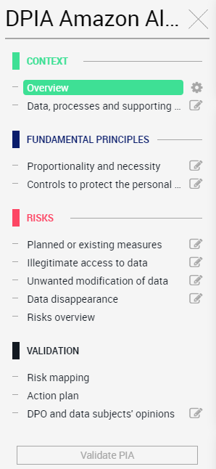




Possible implementation
Standard
Storage Time
Profiling

Slide 47


Relevant standards applicable to the treatment
ISO/IEC
27001:2013, 27017:2015, 27018:2019, 27701:2019, 22301:2019, 9001:2015

Slide 48
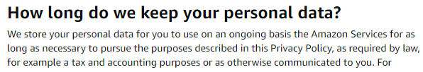

Data collected and processed indicating the retention period
«there's many a slip 'twixt cup and lip»

Slide 49

User preferences for the purposes of customizing and improving the service
«neither fish nor fowl»

Slide 50
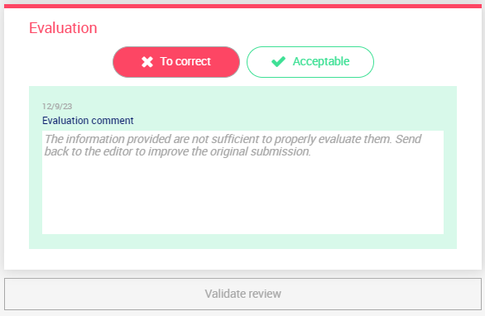
Exchange of information

Slide 51

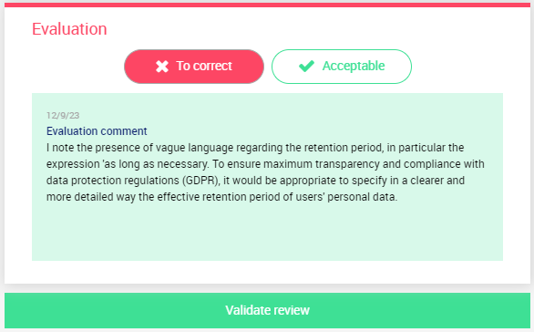
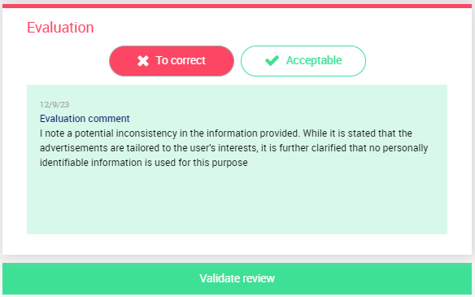
Data Protection Officier

Slide 52
Table of Contents
How VVAs work
Personal Data & GDPR
Alexa & Privacy
DPIA
Violations of GDPR
Possible Solutions

Slide 53



She knows too much
Violations of GDPR
Can you hear me?
Who is the product?
Art. 83

Slide 54
Can you hear me?
Who is the product?
She knows too much

Slide 55

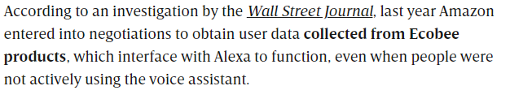



Can you hear me?
COST: 425€ million
CAUSE: Violation of GDPR
DATE: 11 GIU 2021

Slide 56
Can you hear me?
Who is the product?
She knows too much

Slide 57
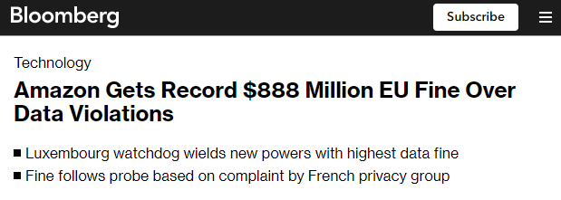

Who is the product?
COST: 746€ million
CAUSE: Violation of GDPR
DATE: 30 LUG 2021

Slide 58
Can you hear me?
Who is the product?
She knows too much

Slide 59
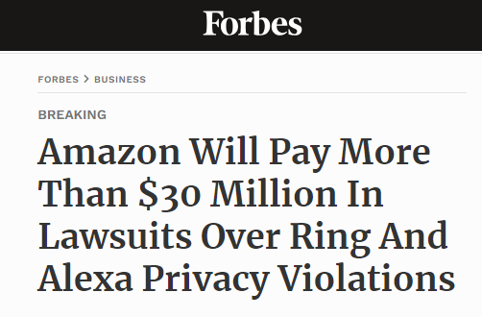




She knows too much
COST: 30€ million
CAUSE: Violation of GDPR
DATE: 31 MAY 2023
REASON: collection of personal data from minors who interacted with Alexa without obtaining their consent.

Slide 60
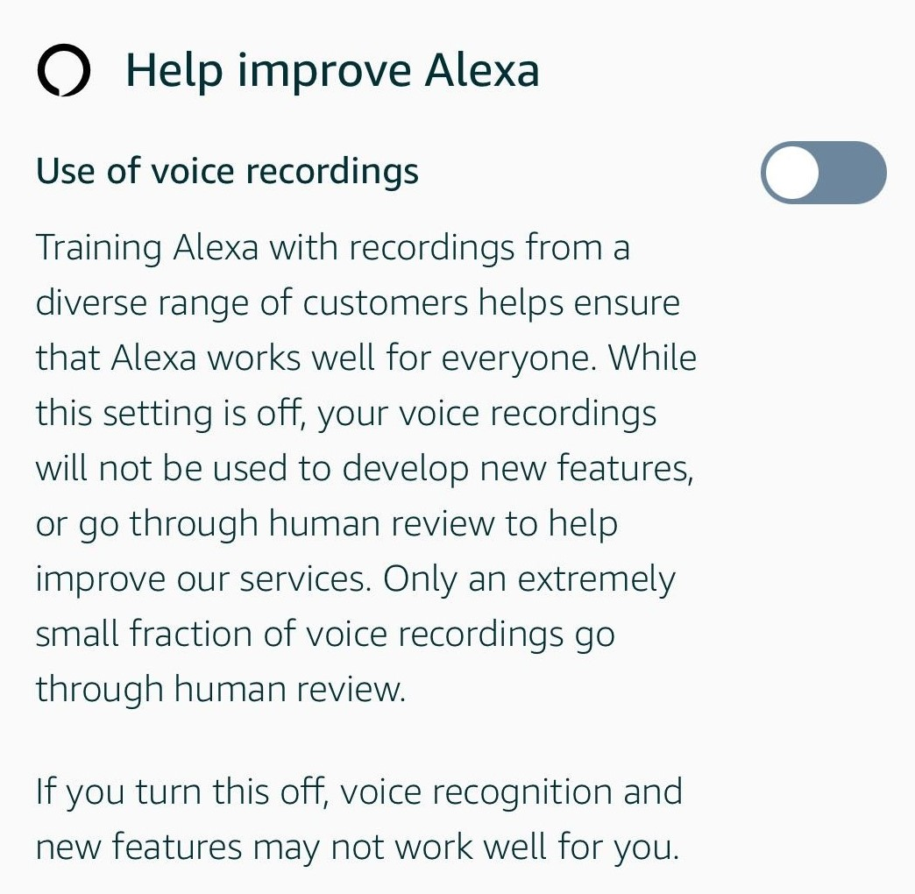


She knows too much

Slide 61
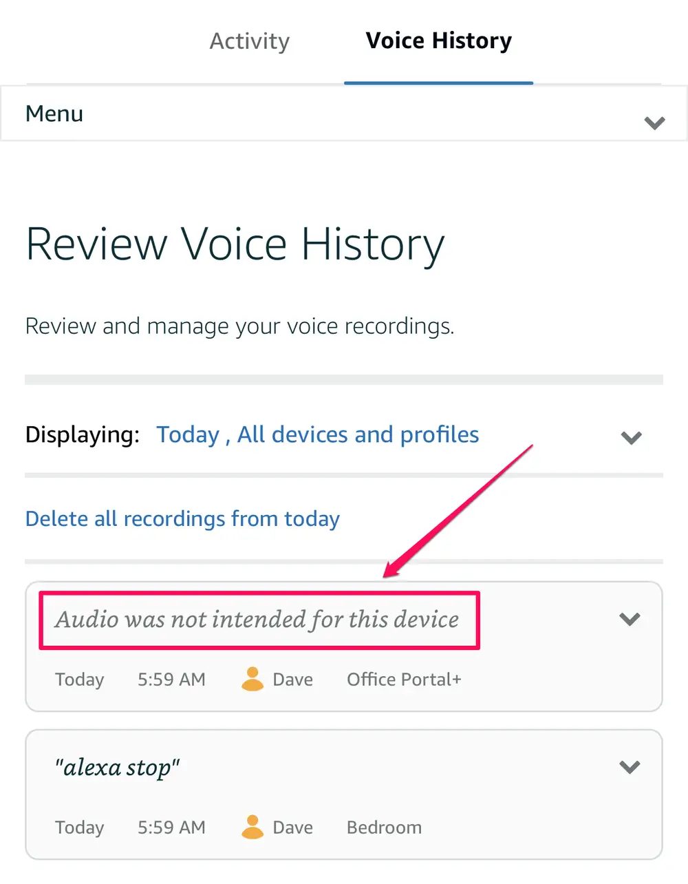


She knows too much
Audio Clip
1. person's name (not the surname)
2. number of his user profile
3. serial number of the device

Slide 62
Table of Contents
How VVAs work
Personal Data & GDPR
Alexa & Privacy
DPIA
Violations of GDPR
Possible Solutions

Slide 63

Possible Solutions

Slide 64
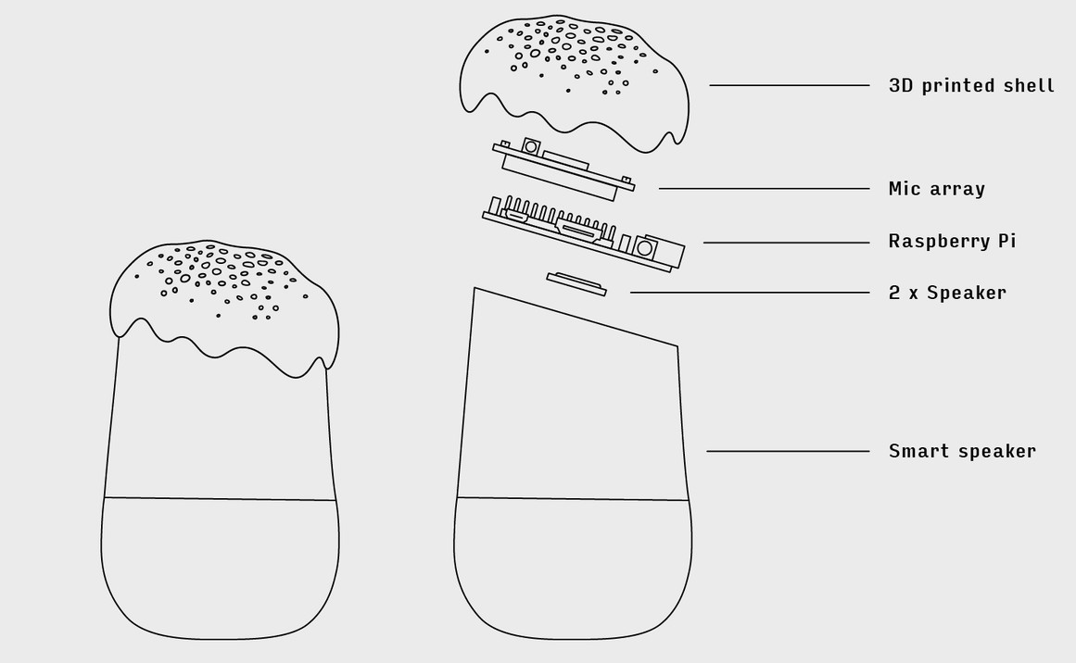
Possible Solutions
Uncommon activation word
Disable microphone or camera
Periodically erase recording history
Advices from GPDP
Update protection system on the device
Set a password for online shopping
Delete any previous account saved on the device
Project Alias
On top of smart speaker
Play a constant white noise, preventing the VVa from listening
Stop when detects the trigger word, thanks to an offline recognition algorithm

Slide 65

Uncommon activation word
Disable microphone or camera
Periodically erase recording history
Update protection system on the device
Set a password for online shopping
Delete any previous account saved on the davice
Possible Solutions
Advices from GPDP
On top of smart speaker
Project Alias
Play a constant white noise, preventing the VVa from listening
Stop when detects the trigger word, thanks to an offline recognition algorithm
Completely transparent solution
No connection needed
Public source code

Slide 66
Possible Solutions
Advices from GPDP
Completely transparent solution
No connection needed
Public source code
On top of smart speaker
Project Alias
Play a constant white noise, preventing the VVa from listening
Stop when detects the trigger word, thanks to an offline recognition algorithm

Slide 67
Thanks for your attention
References
"How Amazon Strong-Arms Partners Using Its Power Across Multiple Businesses"
"Amazon Gets Record $888 Million EU Fine Over Data Violations"
"Amazon Will Pay More Than $30 Million In Lawsuits Over Ring And Alexa Privacy Violations"
"Amazon Staff Are Listening To Alexa Conversations"
"Amazon Staff Are Listening To Alexa Conversations"
EDPB guidelines
Notheastern study: "When speakers are all ears"WHEN SPEAKERS ARE ALL EARS
"Assistenti digitali (smart assistant) I consigli del Garante per un uso a prova di privacy"
Project Alias
PIA software
GDPR
Alexa, Echo Devices, and Your Privacy
Paper: Smart assistant e dati personali: quali rischi per gli utenti?

Slide 68
References
"How Amazon Strong-Arms Partners Using Its Power Across Multiple Businesses"
"Amazon Gets Record $888 Million EU Fine Over Data Violations"
"Amazon Will Pay More Than $30 Million In Lawsuits Over Ring And Alexa Privacy Violations"
"Amazon Staff Are Listening To Alexa Conversations"
"Amazon Staff Are Listening To Alexa Conversations"
EDPB guidelines
Notheastern study: "When speakers are all ears"WHEN SPEAKERS ARE ALL EARS
"Assistenti digitali (smart assistant) I consigli del Garante per un uso a prova di privacy"
Project Alias
PIA software
GDPR
Alexa, Echo Devices, and Your Privacy
Paper: Smart assistant e dati personali: quali rischi per gli utenti?
Thanks for your attention

